Slide 1


Estimating Causal Effects
the prospect engine for brands.
Notes:
[ALL PAGES EITHER NEED m6d logo on side or not, same with page numbers]

Slide 2

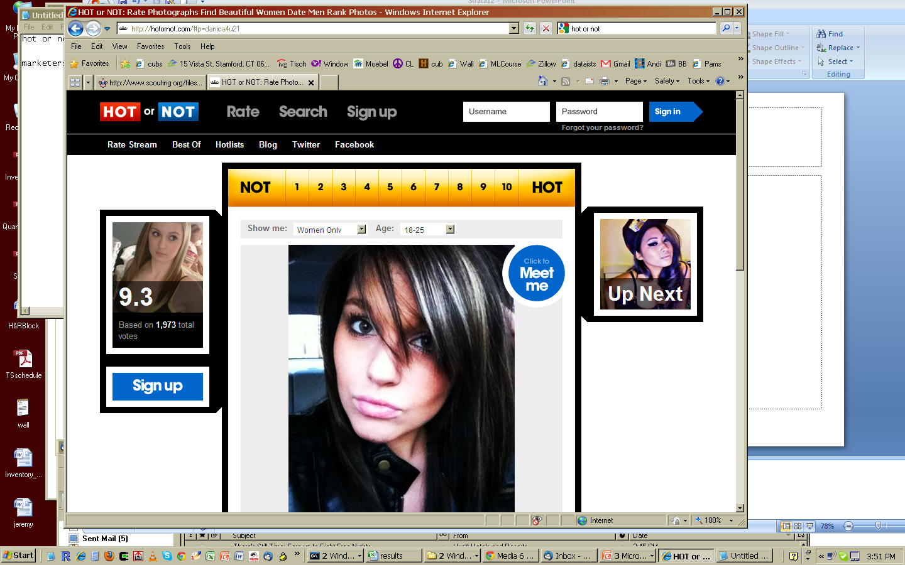


An important decision …
I think she is hot!
Hmm – so what should I write to her to get her number?

Slide 3
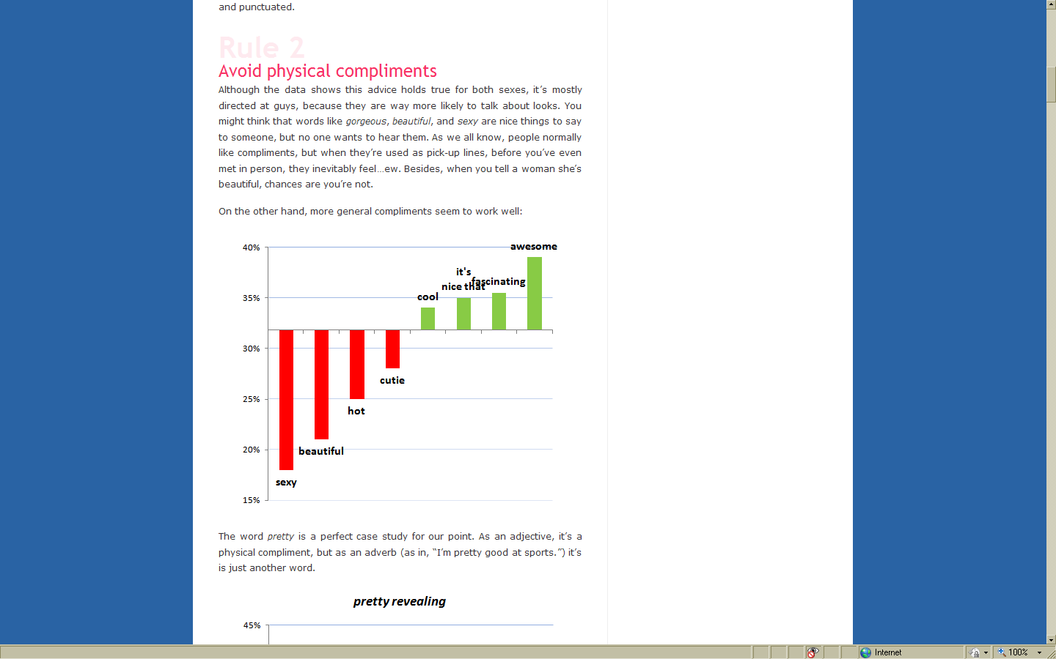


Slide 4
Causal graph
I think she is hot (well, beautiful actually)!
Should I NOT say that I find her beautiful???

Slide 5

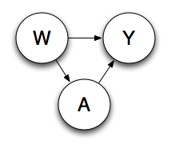

‘ you are beautiful’?
Beauty is Confounding
determines both the probability of getting the number
and of the probability that James will say it
need to control for the actual beauty or it looks like using it will be bad

Slide 6
Estimating Causal Effects - Tutorial
the prospect engine for brands.
Notes:
[ALL PAGES EITHER NEED m6d logo on side or not, same with page numbers]

Slide 7

General approach.
?
1. Ask Question Of Interest
P
2. Make Causal Assumptions
Ψ(P)
3. Translate question into a formal quantity
Ψ(P_{n})
4. Estimate Quantity
Notes:
SEEMS LIKE AN OBVIOUS APPROACH.
SO RARELY FOLLOWED
EXAMPLE LOGISTIC REGRESSION. “I HAVE A BINARY OUTCOME, A BINARY TREATMENT LOGISTIC REGRESSION IS THE APPROACH”, “I HAVE A TIME DEPENDENT OUTCOME, COXPH REGRESSION”

Slide 8
1. Ask question of interest.
what is the effect of
__________ on__________?
?
Treatment → Outcome
Advertising → Customer Behavior
“Beauty” → Getting Number
Drug → Time Until Viral Failure
?
?
?

Slide 9








data structure.
Color
Head
Shape
Sex
CHARACTERISTICS
(W)
TREATMENT
(A)
Yes
No
OUTCOME
(Y)
No
Yes

Slide 10








optimal experiment:
Compare outcome rates of the treated to the rates of the untreated for the same individuals.
3.6 per 1,000
TREAT
(A=1)
DON’T TREAT
(A=0)
1.2 per 1,000
Notes:
Compare conversion rates of seeing an ad to conversion rate without ad for same individuals.
RED,GREY, AND BLUE PEOPLE, MALE AND FEMALE, SQUARE TRIANGLE, AND ROUND HEADS.

Slide 11




optimal experiment:
OR
TREAT?
A
OBSERVE
OUTCOME
Y
SUBJECT
W
OR

Slide 12


reality:
OR
OR
OR
OR

Slide 13

optimal experiment:
Compare outcome rates of treated to outcome rates of untreated for the same individuals.
3.6 per 1,000
TREAT
(A=1)
DON’T TREAT
(A=0)
1.2 per 1,000
Notes:
Compare conversion rates of seeing an ad to conversion rate without ad for same individuals.
RED,GREY, AND BLUE PEOPLE, MALE AND FEMALE, SQUARE TRIANGLE, AND ROUND HEADS.

Slide 14

common approach: A/B testing.
Since we can not both treat and not treat the same individuals. Randomization is used to create “equivalent” groups to treat and not treat.
3.4 per 1,000
TREAT
(A=1)
DON’T TREAT
(A=0)
1.6 per 1,000

Slide 15










Observational Analysis.
Estimate The Effects In The Natural Environment (Observed Data)
TREAT
(A=1)
DON’T TREAT
(A=0)
Notes:
Red people don’t convert so unlikely to see ad. Blue and Grey with round heads are good converters so more likely to see advertisements.

Slide 16
Potential Outcomes And The Full Data:
X = (W,A,Y*(1),Y*(0))
W – Baseline Variables
A – Binary Treatment
Y*(1) – Binary Outcome If Treated
Y*(0) – Binary Outcome If Untreated
If we observed this full data structure how would we measure the effect of A on Y?
Notes:
Compare conversion rates of seeing an ad to conversion rate without ad for same individuals.
RED,GREY, AND BLUE PEOPLE, MALE AND FEMALE, SQUARE TRIANGLE, AND ROUND HEADS.

Slide 17
Potential Outcomes And The Full Data:
X = (W,A,Y*(1),Y*(0))
W – Baseline Variables
A – Binary Treatment
Y*(1) – Binary Outcome If Treated
Y*(0) – Binary Outcome If Untreated
E[Y*(1)] – E[Y*(0)]
Notes:
Compare conversion rates of seeing an ad to conversion rate without ad for same individuals.
RED,GREY, AND BLUE PEOPLE, MALE AND FEMALE, SQUARE TRIANGLE, AND ROUND HEADS.

Slide 18
P
2. Express causal
process.
O = (W,A,Y) ~ P₀
W – Baseline Variables
A – Binary Treatment
Y – Binary Outcome
Notes:
This intervention distribution is a do calculus according to Pearl or a Gcomp formula according to Robins. Also introduce Q and g. Classical example of confounding in graphical model W causes both A and Y.
Define Consistency Assumption
No unmeasured confounders
Positivity Assumption

Slide 19
P
Causal Graph/Structural Equation Model
W = f₁(U_{W})
A = f₂(W,U_{A})
Y=f₃(A,W,U_{Y})
U-Exogenous Variables
Notes:
This intervention distribution is a do calculus according to Pearl or a Gcomp formula according to Robins. Also introduce Q and g. Classical example of confounding in graphical model W causes both A and Y.
Define Consistency Assumption
No unmeasured confounders
Positivity Assumption

Slide 20
P
Example
W = 2*U_{W}
A = I(.5*W + 2*U_{A} > 1)
Y= I(.74 * A + W – 3* U_{Y} > 4)
U-Exogenous Variables
Notes:
This intervention distribution is a do calculus according to Pearl or a Gcomp formula according to Robins. Also introduce Q and g. Classical example of confounding in graphical model W causes both A and Y.
Define Consistency Assumption
No unmeasured confounders
Positivity Assumption

Slide 21
P
Implied factorization of likelihood.
LIKELIHOOD
P₀(O) = P(W)P(A|W)P(Y|A,W)
Notes:
This intervention distribution is a do calculus according to Pearl or a Gcomp formula according to Robins. Also introduce Q and g. Classical example of confounding in graphical model W causes both A and Y.
Define Consistency Assumption
No unmeasured confounders
Positivity Assumption

Slide 22
P
Intervene On The Causal Graph/Likelihood
W = f₁(U_{W})
A = 1
Y=f₃(A=1,W,U_{Y})
W = f₁(U_{W})
A = 0
Y=f₃(A=0,W,U_{Y})
LIKELIHOOD
P_{0,a}(O) = P(W)P(Y|A=a,W)
Notes:
This intervention distribution is a do calculus according to Pearl or a Gcomp formula according to Robins. Also introduce Q and g. Classical example of confounding in graphical model W causes both A and Y.
Define Consistency Assumption
No unmeasured confounders
Positivity Assumption

Slide 23
P
Causal Assumptions (Untestable)
Consistency Assumption / SUTVA
No Unmeasured Confounders
Notes:
This intervention distribution is a do calculus according to Pearl or a Gcomp formula according to Robins. Also introduce Q and g. Classical example of confounding in graphical model W causes both A and Y.
the treatment assignment is made
independently of the potential outcomes of the individual
Define Consistency Assumption
No unmeasured confounders
Positivity Assumption

Slide 24
One additional assumption, Positivity.
For each W there is a positive probability of each treatment.
Observational experimentation. Also known as the Experimental Treatment Assumption (ETA).
If assumption is not valid may consider alternative parameters of interest.
Notes:
Optimal estimation of conditional distributions is the subject of another talk. Suggest data adaptive machine learning using cross validation vs apriori specified logistic regression. If you are not familiar with the advantages of these types of methods think of these machines as logistic regression estimates of these conditional distribution.

Slide 25
Ψ(P)
3. define parameter of interest.

Slide 26
Ψ(P)
These parameters are functions of the distribution under intervention.

Slide 27
Ψ(P)
A very popular parameter.

Slide 28
Ψ(P)
A very popular parameter.

Slide 29

Ψ(P_{n})
4. estimate parameter.
Optimal Experiment
A/B Testing
MLE Based Substitution Estimator (MLE)
Inverse Probability Estimators (IPTW)
Double Robust Estimating Equations (A-IPTW)
Targeted Maximum Likelihood Estimation (TMLE)
Notes:
For each estimator I will give an idea aboutA. The form of the estimator (Please don't get caught up in the details of the math)1. The logic behind how it works/strategy2. Its properties/assumptions3. Limitations

Slide 30
P
Recall the Likelihood
LIKELIHOOD
g_{A}
P₀(O) = P(W)P(A|W)P(Y|A,W)
Q_{W}
Q_{Y}
Notes:
This intervention distribution is a do calculus according to Pearl or a Gcomp formula according to Robins. Also introduce Q and g. Classical example of confounding in graphical model W causes both A and Y.
Define Consistency Assumption
No unmeasured confounders
Positivity Assumption

Slide 31



two machines: Q_{Y,n} and g_{A,n}
P(A|W)
P_{n}(A| )
g_{A,n}
P_{n}(Y| )
Q_{Y}
P_{n}(Y| )
Q_{Y,n}
Notes:
Optimal estimation of conditional distributions is the subject of another talk. Suggest data adaptive machine learning using cross validation vs apriori specified logistic regression. If you are not familiar with the advantages of these types of methods think of these machines as logistic regression estimates of these conditional distribution.

Slide 32
estimating Q_{Y} and g_{A .}
Statistical model is the set of possible conditional distributions for Q_{Y} and g_{A}.
Many tools exist for estimating binary conditional distributions.
Logistic regression, SVM, GAM, Regression Trees, etc.
Data adaptive estimation methods that use cross validation.
SuperLearner (R package, Eric Polley)
Causal analyses will benefit from the advances in parallelized routines for data adaptive estimation.

Slide 33





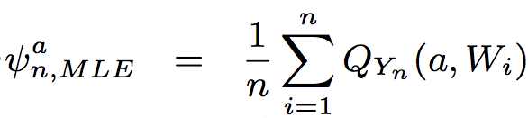


MLE based substitution estimator (MLE).
Strategy
Adjust For Confounding Through Q.
Predict how each observed browser will behave had they been shown an ad and had they not been shown an ad.
Q_{Y}
Q_{Y,a=1}
Estimator
Q_{Y}
Q_{Y,a=0}

Slide 34


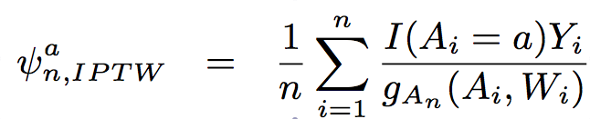
inverse probability weighted estimators (IPTW).
Strategy
Adjust For Confounding Through g_{n}.
Weight individuals that are unlikely to be shown an advertisement more than individuals that are likely to be shown an advertisement
P_{n}(A| )
=
1/2
Estimator
P_{n}(A| )
=
1/10

Slide 35
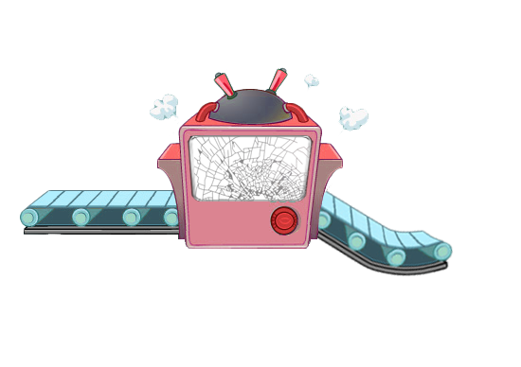
double robust estimators.
What if Q_{Y,n} or g_{A,n} are broken? The MLE based estimator and IPTW rely on consistent estimates of Q and g respectively.
g_{A}
g_{A,n}
P(A| )
P(Y| )
Q_{Y}
Q_{Y,n}
P(Y| )
Notes:
What does broken mean? Mis-specified initial model. Also touch on that they are chosen for prediction not parameter of interest and smoothing vs interaction example. [NEED TO INDICATE OR]

Slide 36
augmented – IPTW (A-IPTW).
Strategy
Adjust For Confounding Through Q and g.
Augments IPTW estimator with information from Q.
Alternatively adjusts MLE with information from g.
OR
Estimator

Slide 37
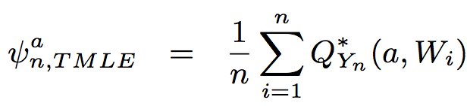
targeted maximum likelihood estimator (TMLE).
Strategy
Adjust For Confounding Through Q and g.
Predict how each observed browser will behave had they been shown ad and had they not been shown ad.
The new machine Q* is calibrated with concern for the parameter of interest.
R package “tmle” at CRAN
Q_{Y}
Ψ(Q_{Y})
Q*_{Y,n}
Estimator
Q_{Y}
Ψ(Q_{Y})
Q*_{Y,n}

Slide 38

creating Q*_{Yn .}
QYn is updated to Q*Yn using a clever covariate that is a function of g.
Update is done through the use of a parametric submodel.
Update is a univariate regression with the initial QYn as an offset.
Q_{Y}
g_{A}
Q_{Y}
Ψ(Q_{Y})
Q*_{Y,n}

Slide 39
Causal analysis in online display advertising
the prospect engine for brands.
Notes:
[ALL PAGES EITHER NEED m6d logo on side or not, same with page numbers]

Slide 40

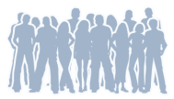










the life of a browser process.
1. Observe people taking actions and visiting content
2. Use observed data to build list of prospects
3. Subsequently observe same browser surfing the web the next day
4. Browser visits a site where a display ad spot exists and bid requests are made
5. Auction is held for display spot
6. If auction is won display the ad
7. Observe browsers actions after displaying the ad
Notes:
Build a model on people taking actions. Surfing web next day. Hits a spot where an ad may be served. Bidding Process. Show an Ad. Then observe if they take an action. GET BID REQUEST.

Slide 41
What do advertisers want?
Conversions?
1.05X
1.11X
2.26X
0.92X
1.31X
2.62X
TELECOM COMPANY A
TELECOM COMPANY A
TELECOM COMPANY B
TELECOM COMPANY B
TELECOM COMPANY C
TELECOM COMPANY C
Notes:
Assessing the impact of the advertising it is clear that in these cases it is more advantageous to show advertisements to new prospects.
Compared to cost per conversion goals. ROI, Gross Conversion Rates.

Slide 42


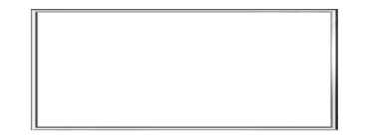


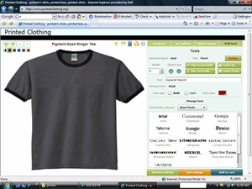
question of interest.
?
what is the effect of
display advertising
on customer conversion?
display advertising
Showing/Not showing a browser a display ad.
customer conversion
Visiting the advertisers website in the next 5 days.
Notes:
[I like ? In middle, but it needs to be lightened up]

Slide 43
?
1. state question.
What is the effect of
display advertising on customer
conversion?
display advertising
Showing/Not showing a browser a display ad.
customer conversion
Visiting the advertisers website in the next 5 days.

Slide 44
practical concerns. associated with doing A/B testing
Cost of displaying PSAs to the control (untreated group).
Overhead cost of implementing A/B test and ensuring that it is done correctly.
Wait time necessary to evaluate the results.
No way to analyze past or completed campaigns.
Notes:
Ask Brian What PSAs are?

Slide 45






“what if” causal analysis adjusting for confounding
Need to adjust for the fact that the group that saw the advertisement and the group that didn’t may be very different.

Slide 46
sampling/analysis.
Select Prospects that we got a bid request for on day 0.
Observe if treated on day 1. For those treated A=1 and those not treated A=0. Collect W.
Create outcome window that is the next five days following treatment and observe if event occurs.
Estimate parameters using the methods previously described.

Slide 47
results.

Slide 48
IPTW and A-IPTW blow up under positivity violations.

Slide 49
summary results.
median relative lift of 90%

Slide 50
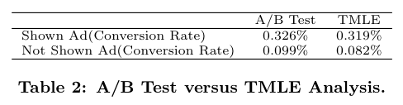
method validation: A/B Test vs analytic estimate

Slide 51
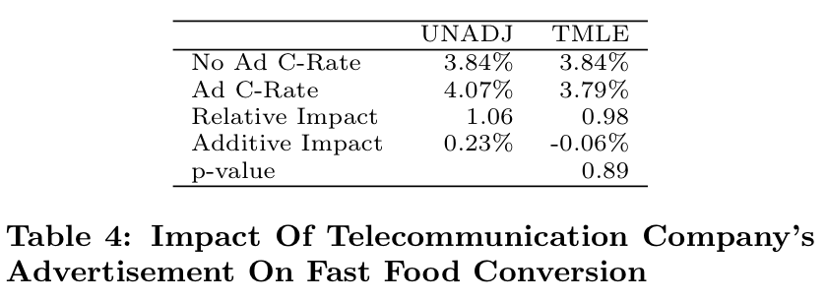
method validation: negative test
Notes:
check for unmeasured confounding

Slide 52


gross
conversion
rates.
are only part
of the story
-0.2%
TELECOM COMPANY A
TELECOM COMPANY B
TELECOM COMPANY C

Slide 53

effectiveness
varies by
marketer.
1.08X
3.77X
4.23X
1.08X
B2B COMPANY A
B2B COMPANY B

Slide 54

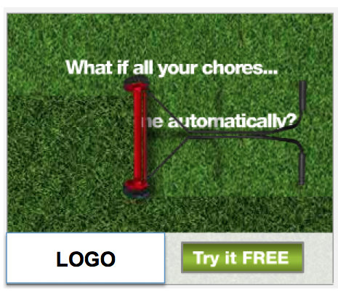
effectiveness
varies by
marketer
& campaign.
B2B COMPANY A
B2B COMPANY B
Retargeting Impact: 1.08X
Prospecting Lift: 4.23X
Retargeting Lift: 3.77X
Prospecting Lift: 1.08X

Slide 55


creative
matters.
NO LIFT
Brand is buried; sweepstakes, not the brand, is the primary message
NO LIFT
Call to action is inconsistent with primary message
This campaign drove no significant lift from either retargeting or new customer prospects, likely due to ineffective creative.

Slide 56
Original Data Structure
O = Observed data
W = Baseline Covariates
A = Treatment Assignment
T = Event Time
C = Censoring Time

Slide 57
Data Structure With Censoring and Event Process Cast as Binary Variables
O = Observed Data
W = Baseline Covariates
A = Treatment Assignment
N(t) = Event Counting Process: Remains 0 until event occurs at time t and then jumps to 1.
A(t) = Censoring Counting Process: Remains 0 until censoring occurs at time t and then jumps to 1.
t_{k} is the pre-specified time at which to estimate survival probability.

Slide 58
Causal Graph/NPSEM
N(1)
N(2)
. . .
N(K-1)
N(K)
A
W
A(1)
A(2)
. . .
A(K-1)
Notes:
The causal graph allows us to define counterfactuals
Assumptions are made in causal graph
Ordering
Nodes are functions of parents only
CAR/RA
Consistency Assumption

Slide 59
Likelihood Of Observed Data
Distribution of Baseline Covariates, Q₁
Event Hazard, Q₂
Treatment Mechanism, g₁
Censoring Mechanism, g₂
Notes:
Note that p(w) is distribution of covariates, p(A) and p(A|W) are treatment mechanism, p(dN1(t)|.) is event process and p(dN2(t)|.) is censoring process. We commonly refer to the treatment process as g1, the censoring process as g2 and the combined covariate and event process as Q as I may refer to them in this way later.

Slide 60
Causal Graph/NPSEM Under Intervention
N(1)
N(2)
. . .
N(K-1)
N(K)
A
W
A(1)
A(2)
. . .
A(K-1)

Slide 61
Defining a Parameter of Interest
Distribution of Baseline Covariates, Q₁
Event Hazard, Q_{2,A-a,dA(t)=0}
Parameters of interest:
Where,

Slide 62
Properties of T-MLE with survival outcome
Double robust: Rely on consistent estimates of either right censoring and treatment mechanism g₁(A|W), g₂(.|A,W), or survival function S(.|A,W)
If independent censoring and randomized treatment:
No risk of bias
Gains in precision
With informative censoring and/or observational treatment.
Bias reduction (Standard approaches often biased)
Notes:
By modelling treatment even when it is known to be randomized one may also adjust for some emperical confounding.

Slide 63
RMSE of Estimating Treatment Specific Survival
 | Highly Identifiable |  | Mid Identifiable |  | Weakly Identifiable
Method | Well Specified Q | Badly Specified Q | Well Specified Q | Badly Specified Q | Well Specified Q | Badly Specified Q
IPW | 0.029 | 0.029 | 0.071 | 0.071 | 0.106 | 0.106
MLE | 0.027 | 0.030 | 0.028 | 0.047 | 0.028 | 0.049
AIPW | 0.027 | 0.029 | 0.054 | 0.061 | 0.070 | 0.081
TMLE | 0.028 | 0.031 | 0.029 | 0.037 | 0.029 | 0.040
Notes:
1) C-TMLE is super efficient
2) TMLE achieves efficiency bound even under High ETA while DR IPCW estimate is not efficient.

Slide 64
Percent Of Time 95 Percent CI Based on Variance Estimates From IC Includes Truth (Mean CI Width)
 | Highly Identifiable |  | Mid Identifiable |  | Weakly Identifiable
Method | Well Specified Q | Badly Specified Q | Well Specified Q | Badly Specified Q | Well Specified Q | Badly Specified Q
IPW | 98% (.14) | 98% (.14) | 92% (.24) | 92% (.24) | 88% (.27) | 88% (.27)
AIPW | 94% (.11) | 95% (.12) | 95% (.18) | 95% (.22) | 94% (.20) | 94% (.25)
TMLE | 94% (.11) | 94% (.12) | 95% (.11) | 92% (.13) | 94% (.11) | 89%* (.13)
*Bootstrap confidence intervals which used the quantiles of the bootstrap sample as opposed
to Wald type confidence intervals included the truth 94 percent of the time for TMLE and were
slightly tighter than the Influence curve based intervals.
Notes:
1) Coverage of c-TMLE almost as good as knowing which variable causes ETA problem and removing it from treatment mechanism.

Slide 65
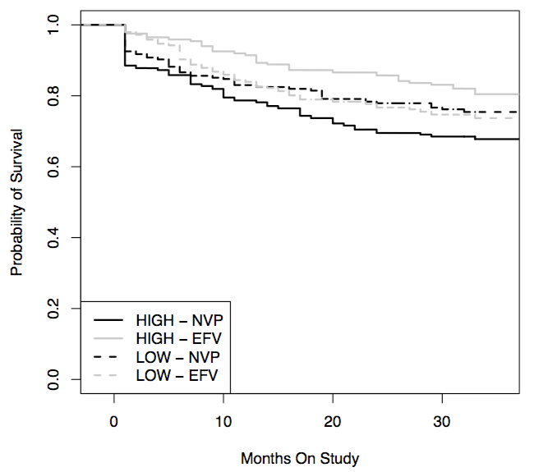
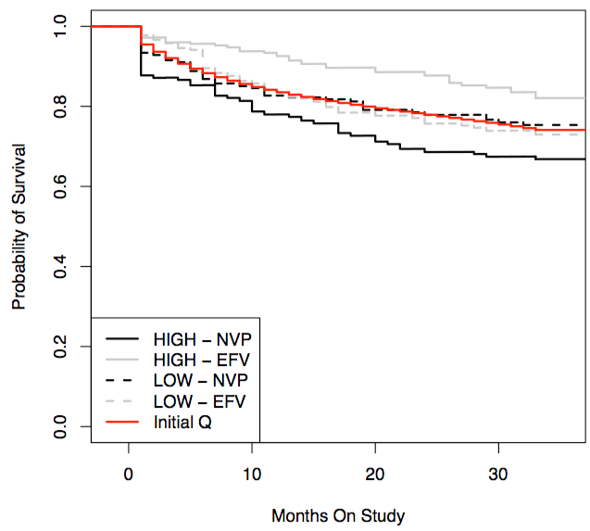
Double Robustness Example
TMLE- Data Adaptively Chosen Q
TMLE – Purposely Mis-pecified Q

Slide 66
Simulation Results For Time Dependent Informative Censoring (Truth = .470)

Slide 67
Simulation Results For Independent Censoring (Truth = .470)

Slide 68
references.
O. Stitelman, B. Dalessandro, C. Perlich, and F. Provost. Estimating The Effect Of Online Display Advertising On Browser Conversion. In Proceedings of KDD, Annual International Workshop on Data Mining and Audience Intelligence for Online Advertising, ADKDD ’11.
M. van der Laan and S. Rose. Targeted Learning: Causal Inference for Observational and Experimental Data. New York, NY: Springer Publishing Company, 2011. http://www.targetedlearningbook.com/
‘tmle’ R Package http://cran.r-project.org/web/packages/tmle/index.html
R. Kohavi and R. Longbotham. Unexpected results in online controlled experiments. ACM SIGKDD Explorations Newsletter, 12(2):31–35, 2010.
R. Lewis and D. Reiley. Does retail advertising work: Measuring the effects of advertising on sales via a controlled experiment on yahoo. Technical report, Working paper, 2010.
D. Chan, R. Ge, O. Gershony, T. Hesterberg, and D. Lambert. Evaluating online ad campaigns in a pipeline: causal models at scale. In Proceedings of KDD, KDD ’10, pages 7–16, New York, NY, USA, 2010. ACM.
Notes:
Add talk on KDD WORKSHOP [CAN YOU FORMAT NICER]

